Slide 1


Campus Safety Plan
Gary J. Montecuollo
Chief of police

Slide 2
Overview
Campus Safety Mission
Availability/Location of College Police
How to Contact Us
Safety and Security Structure
Safety and Security Roles
Past Safety Actions
Future Safety Precaution Goals
Summary

Slide 3
Mission
Commitment to student learning and success
Service to the campus community -
public safety emphasis
Commitment to community based policing and interaction with stakeholders.

Slide 4
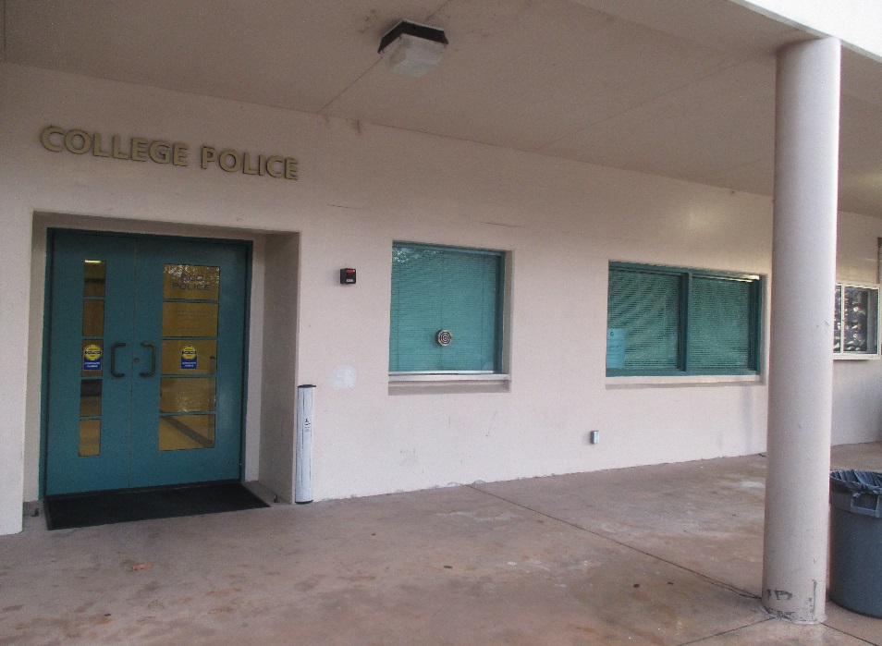
Availability/Location of College Police
College Police is available 365 days a year.
Located on the Verdugo Campus inside
Sierra Madre Building Room 153.
(outdoor lobby phone is also available).

Slide 5
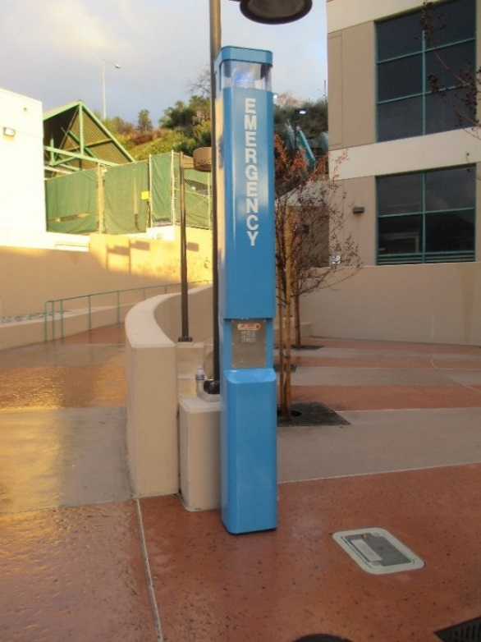
How to Contact Us
Emergencies:
Campus phone X 4000
Direct dial 818 551-4911
On Campus Call-Boxes
General
Campus Phone X 5205
Direct dial 818 551-5205
In Person:
Verdugo Campus Sierra Madre Building Room 153
Online:
https://www.glendale.edu/about-gcc/college- police/contact-form

Slide 6
Safety and Security Structure
1 Chief
2 Sergeants
9 Officers (includes 1 Corporal)
3 Dispatchers
10 Cadets
15,000 -18,000 Students
1,200 Employees
3 campuses

Slide 7
Safety and Security Roles
  Enforcement of criminal law and college policies
  Response to calls for service
  Observe, respond and mitigate safety & security issues
  Safety presentations to students and employees
  Ongoing P.O.S.T training (Peace Officer Standards and Training)
  Emergency preparedness training & presentations
  Evacuation and earthquake drills
  Training Campus Security Authorities (CSA’s)
  Investigation liaison with local law enforcement
  Networking/training exercises with law enforcement partners for active violence incidents
  Police Advisory Committee
  Assist and collaborate training for de-escalation, mental health and workplace safety

Slide 8
Past Safety Actions
  MOU Update and Implementation
  Hiring and Training Police Dept. Staff
  Training College Community
  Behavioral Management Team

Slide 9
Past Safety Actions
Locking systems for classrooms and offices
Campus phone intercom emergency notification system for classrooms and offices.
Mountain St/Verdugo Rd corner message sign upgrade for campus information and emergencies
Technology upgrade (body worn cameras, dispatch center and police server upgrade)
Pay and Display parking permit upgrades.

Slide 10
Future Safety Precaution Goals.
  Investigative Process Streamlined
  Area-C Collaboration
  Emergency Notification Upgrade
  Signage and Roadway Repair
  Equipment Upgrade
  Vehicle Fleet Upgrade
  Terrorism Liaison Officers
  Technology Upgrade with GPD

Slide 11
Future Safety Precaution Goals…
Emergency planning and full scale exercises
Hiring for vacant Police Officer positions
Hiring for Communications and Records Specialist vacancies
Increased security cameras for the campus
Emergency Procedures Guide update
Update AED’s on campus locations.

Slide 12

Safety a Collaborative Process – Requires Integration of Resources
Campus Input
Emergency Plans
Networking,
Resources
Training

Slide 13
Summary
Access and transparency
(active process)
Collaboration with stakeholders – in advance
Utilize Evidence Based Policing and Research
Communication is essential
  (education, notification, reporting)
Not immune to crime or emergencies – preparation is the key
Revised January, 2024

